Slide 1
税务规划基础
报税系列第七课

Slide 2
免责声明
本次课程不对会中包含的信息中获得的任何结果做出任何保证或其他承诺。任何人都不应在未事先咨询自己的税务师、会计师或财务顾问并进行自己的研究和尽职调查之前做出任何财务决定。
本次课程上包含或通过本次课程提供的内容仅用作信息共享和教育目的。它无意也不构成法律建议或投资建议，也不构成专业客户关系。不保证或保证此内容的准确性、完整性、充分性和时效性。您使用本课程上的信息或从本课程上获取资料的风险由您自行承担。

Slide 3
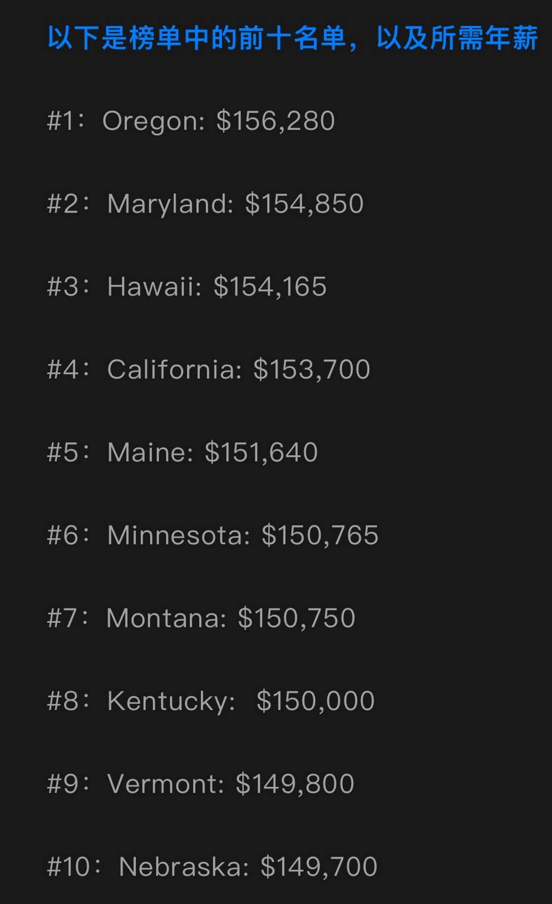
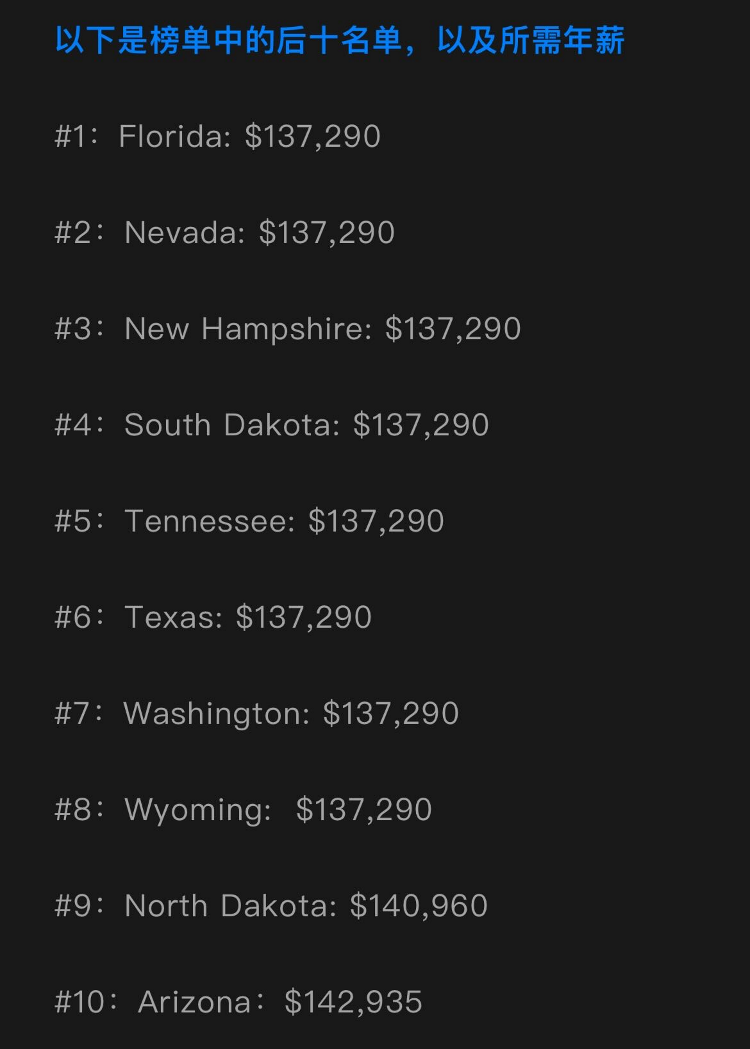
美国各州税负比较
Oregon: 36%
California: 34.92%
Massachusetts: 32.23%
Florida: 27.16%

Slide 4
Income
- Payroll Tax
- Income Tax
Investment
- Capital Gain Tax
- Dividend/Interest Tax
Wealth Transfer
- Gift Tax
- Estate Tax

Slide 5
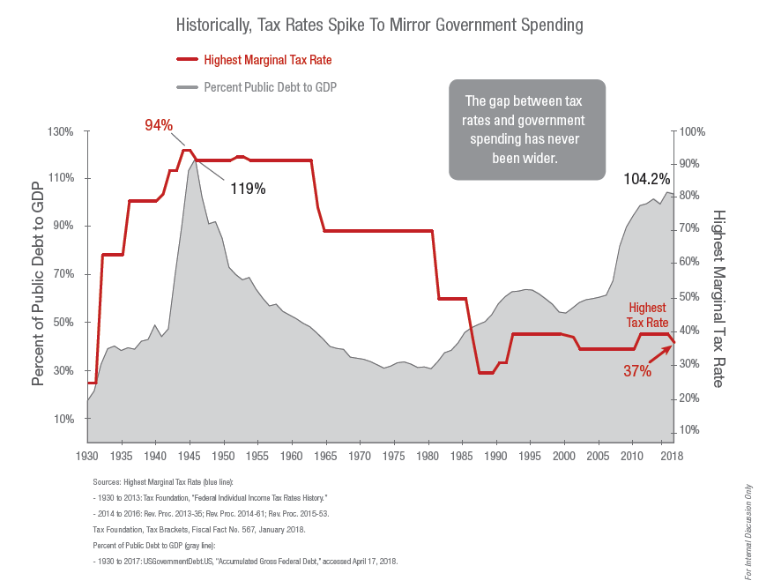
Would you rather pay tax now or defer to the future?

Slide 7
Tax Formula
Gross Income
- Deductions allowed (Schedule 1)
= AGI (Adjusted Gross Income)
- Standard/Itemized Deductions
= Taxable Income
x Tax Rate
= Tax
- Tax Credits/Tax withholding
= Tax Refund/ Tax Owe?
W2

Slide 8
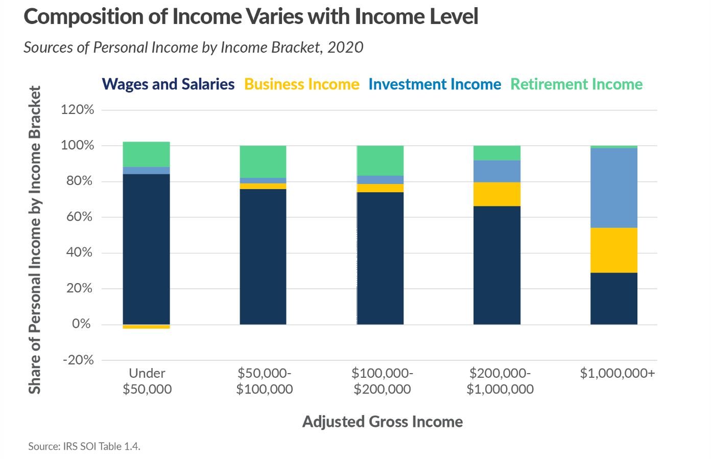
Income Structure Determines Your Wealth

Slide 9
Employee
Business Sch C/E
Earn 收入
Pay Tax 交税
Spend 支出
(Not tax deductible)
Earn 收入
Spend 支出
(Tax deductible)
Pay Tax 交税

Slide 10
Deduct Immediately if Qualified
Max $245,000
Unlimited
Computers, Furniture, Printers, Equipment
Up to $61,000 / Business
Unlimited
100% 2022, 50% 2023
Home Office
Unlimited

Slide 11
Deductions & Credits
Deductions
Qualified plan contribution ($20,500, $27,000 if 50 and above)
IRA contribution ($7,000 / $8,000), subject to income threshold
HSA ($4,150/$8,300, age 55+: add 1000)
Loss Harvesting to offset capital gain.
Charity Donation
Tax Credits
American opportunity credit: first 2000+25% of the next, up to $2500 (phase out starts $160,000- $180,000)
Life time learning credit:20% of first $10,000, up to $2000 (phase out $160,000 - $180,000)
Child tax credit
$2000 for each qualifying child <17, $1700 refundable
$500 for each qualifying dependent
Foreign earned income exclusion
$126,500 for 2024
Notes:
Income grow and when getting aged

Slide 12
HSA (Health Saving Account)
必须满足以下要求：
HDHP：deductible: Single / Family: $1600/$3200; Out of Pocket Limit: Single/Family: ($8,050/$16,100)
Not be enrolled in a health plan that is not an HSA-eligible plan, such as a full purpose health care flexible spending account (FSA)
Not be enrolled in Medicare
Not claimed as a dependent on someone else's tax return
每年的截止日期：You generally have until the tax filing deadline to contribute to an HSA. In most tax years, this is at or around April 15.
存钱抵减当年收入
可以用于投资，投资增值免税
取钱用于医疗支出免税，用于其他用途则要交税+20%的罚款
65岁之后不能再存

Slide 13
边际税率 VS 平均税率
$200,000 Taxable Income (MFJ)
Tax = $30,427 + ($200,000 - $178,150) * 24% = $35,671
Marginal Tax Rate: 24%
Average Tax Rate: 17.84%
Every Dollar of Tax Income you Save: You Save 24 Cents

Slide 14
Capital Gains Taxes 2023
Single | 2022 | Tax Rate | 2023
 | $0 - $41,675 | 0% | $0 - $44,625
 | $41,676 - $200,000 | 15% | $44,625 - $200,000
 | $200,001- $459,750 | 18.8%* | $200,000 - $492,300
 | Above $459,750 | 23.8%* | $492,300+
Joint | $0 - $83,350 | 0% | $0 - $89,250
 | $83,351 - $250,000 | 15% | $89,250 - $250,000
 | $250,001 - $517,200 | 18.8%* | $250,000 – $553,850
 | Above $517,200 | 23.8%* | Above $553,850
The rate structure under TCJA does not apply to taxable years after Dec 31, 2025
* Reflects addition of 3.8% Surtax on Investment Income, which is applied based on Adjusted Gross Income (AGI)
Sources: Rev. Proc. 2022-38 Oct. 18, 2022, Rev. Proc. 2021-45 Nov. 10, 2021
Investment earnings commonly include interest, dividends, income from rental properties, royalties and the profit you earn from trading stocks.
Notes:
The 2023 standard deductions adjusted for inflation are $13,850 (single), $20,800 (head of household) and $27,700 (married filing jointly).
The Tax Cuts and Jobs Act of 2017 increased the Child Tax Credit to $2,000 of which $1,400 would be refundable. The child tax credit phases out beginning at $200,000 of adjusted gross income for single filers and $400,000 for joint filers.
The American Rescue Plan Act signed by President Biden in 2021 increased the Child Tax Credit to $3,600 for children under 6 and $3,000 for children ages 6 - 17 and made the credit fully refundable. [There had been much discussion in Washington regarding potential plans to maintain these higher rates, but these rates did drop down to the TCJA rates for 2022.]

Slide 15
常见的投资税误区
1. 只要不卖就不用交税
分红/股利
2. 长期持有就可以享受长期投资税率的优惠
注意投资经理的投资风格
3.亏损不用交税
Wash Sale （假售回购）

Slide 16
Where to Grow Money
TAX Advantage
TAX NOW
TAX LATER
Saving/CD
Stock
Mutual Fund/ETF
Rental Income
401(k)/403(b)
IRA/SEP-IRA
Annuity/Pension
Investment Property Capital Gain
Roth-IRA
529
7702
Notes:
There are only 3 buckets for us to save money according to tax advantage.

Slide 17
What You Have vs What You Keep (40 Years View)
$466,739
$10,000 Invested into S&P 500 for 40 years:
Tax Free: $466,739
Tax Deferred (30% Tax) : $326, 717
Taxable (30% Tax Annually): $93,000
80%
$93,000

Slide 19
Roth IRA/7702

Slide 20
资产传承规划
Power of attorney
Will
Trust
Guardianship
Health Proxy

Slide 21
Ideal Tax Saving Strategy
7702 Plan
Short Term
< 5 Years
Mid Term before age 59.5
Long Term before age 72
Long Term after age 72
Roth IRA
Trust
Legacy Business
Other Investment Plan
Bank/MF/Bond
IRA/401(k) / Business Tax Saving Acct
529 Plan
Annuity

Slide 22
三大资产保护工具
ERISA(The Employee Retirement Income Security Act)– 保护合格退休计划
Trust – 保护个人资产和权益
Life Insurance - 保护现金流

